Slide 1
Unoccupied Building Search การตรวจอาคารร้าง
Module 06
V1.0

Slide 2
Learning Objectives
Terminal Learning Objective
Describe unoccupied building search and associated hazards
Enabling Learning Objective
Describe potential threats and indicators with an unoccupied building search
Recognize tactical risk during the mission
Identify common threats involved when conducting an unoccupied building search

Slide 3
Threat Assessment การประเมินภัยคุกคาม
What was the building used for?
อาคารใช้ทำอะไร
How long has it been empty?
อาคารร้างมานานหรือยัง
When was the last know activity?
ล่าสุดมีอะไรเกิดขึ้นในอาคาร
Why is it unoccupied?
ทำไมอาคารร้าง
Who was the last to use it?
ใครใช้อาคารนี้ล่าสุด
เจตนา
ภัยคุกคาม
สถานที่
Notes:
Entry into an unoccupied building should not be taken lightly. Obviously, not all will be protected by IEDs but it only takes one to be lethal. Always considered an unoccupied building dangerous until proven otherwise.
The most likely form of attack while conducting an unoccupied building search is a victim operated IED. They will be placed on the most likely avenues of approach to the building. Entry points, windows, stairs or behind doors is the most likely locations for a switch. If the building contains valuable materials it is possible the adversary will observe the objective which allows for them to employ a command device. Insurgents observing a compound may also conduct a shoot in order to harass or disrupt search operations.

Slide 4
Unoccupied อาคารร้าง
Entry การเข้าในอาคาร
Method of entry dictated by type of threat
วิธีการเข้าจะขึ้นอยู่กับภัยคุกคาม
Assets, time available, intelligence, and type of compound are other considerations to take into account
สิ่งที่ต้องคำนึงถึงคือ อุปกรณ์ที่มี เวลา และ ประเภทของอาคาร
Tactical risks relate to those posed by the threat, such as booby-trapped doors, IEDs, and sniper fire
ความเสี่ยงที่เกี่ยวกับภัยคุกคามนั้น เช่น ประตูอาจติด booby trap, IED, และ sniper
Notes:
Entry (unoccupied)
This could be situation dependent or a mission essential target. Is entry mission critical? Is bypassing feasible?
The adversary may use unoccupied buildings, including abandoned ships, for storing resources. Such buildings must always be treated with great suspicion, as the adversary may use them to emplace improvised explosive devices and booby traps. Assume all unoccupied buildings being searched are booby trapped. A booby trap, usually of an explosive and lethal nature, is design to catch the innocent. It is aimed at creating uncertainty, lowering the moral of military forces and hindering their movements. A successful IED is simply constructed, often from household items (clothes pins, syringes, batteries, and pressure cooker). It is actuated by a normal human action, such as open a door, switching on a light, or walking on the floor. To gain the greatest chance of success, the IED emplacer must know the drills and habits of coalition forces. All troops must be trained to recognize the indicators of IED activity within their operating environment. Indicators of IEDs and booby traps include the following:
- Graffiti indicating sometime of warning to locals
- Absence of locals and livestock in the surrounding area
- Disturbance of ground surface, scattered or loose soil, freshly dug holes or pavement patching
- Minor obstruction, forcing the searchers to be channeled
- Loose floor boards, window ledges, or stair treads
- Strange smells (use explosive detector)
- Pins, wires, string, or nails where they would not normally be expected
Unoccupied compound. Any unoccupied compound should be physically cleared of IEDs. This operation should be conducted in 5 stages:
a. Secure. Ensure that there are no external INS threats.
b. Isolate. Prevent any ingress into the area.
c. Clearance to entry point. A random route should be chosen, CFs need to be aware that INS may attempt to target areas where soldiers are likely to crouch dwn, take up firing positions or look around compound corners.
d. Clearance of the entry point.
Visual check (Consider threat from inside-including dogs)
Trip wire feel
Physical check – 3D sweep using metal detector
Finger tip/touch search (if time permits)
e. Clearance of Compound. The clearance procedures are repeated for each building & room entered within a compound. A full suite of ECM is to be carried by the clearance team to maximize spacing & reduce overall threat. Search dogs can only be used once the area has been cleared of VOIEDs.

Slide 5
Unoccupied Building อาคารร้าง
Notes:
Amplify the differences in threats when conducting an unoccupied building search in comparison to an occupied building search.
Question: What stands out as a potential threat to you and your squad in this photo?
Answer: Discuss on the next slide.
(Slide photo unoccupied building)

Slide 6
Unoccupied Building
Notes:
Amplify the differences in threats when conducting an unoccupied building search in comparison to an occupied building search.
Question: What stands out as a potential threat to you and your squad in this photo?
Answer: Discuss the entrances to the building as possible VP/VA. IED’s placed within the compound wall.
Devices and trip wires can be laid where mouse holes have been created in walls to allow compound access.
Visual detection still remains the number one method for identifying the presence of an IED!!!
(Slide photo unoccupied building)

Slide 7
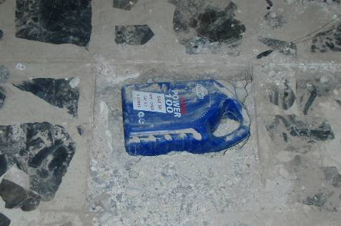
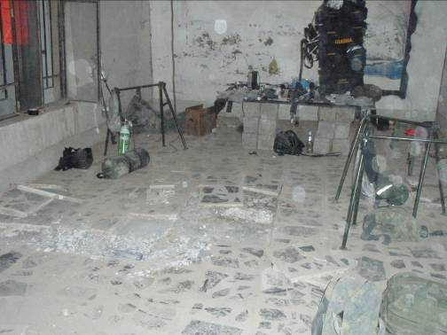
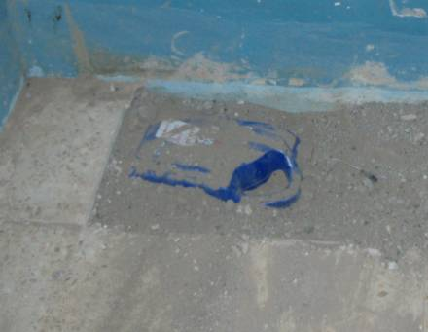
Common Threats ภัยคุกคามที่พบบ่อย
Emplaced IED / IED ซุกซ่อน
1st HME Container
2nd HME Container
3rd HME Container
Notes:
This slide is in reference to the incident as briefed by the J2 regarding a booby trapped building that was occupied by CF but luckily never fired by function. Of key note here is that the building was occupied for more than 24 hours prior to IED discovery and visitors to the Brigade and Battalion TOCs included the Division Commander and his staff, and an Iraqi 3 star general and his staff. In all there were 120 military personnel evacuated at the time EOD discovered the IED setup.

Slide 8
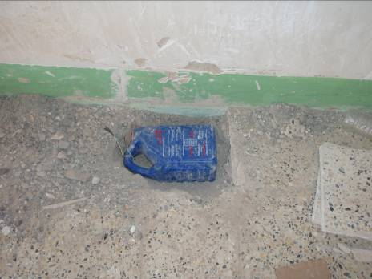
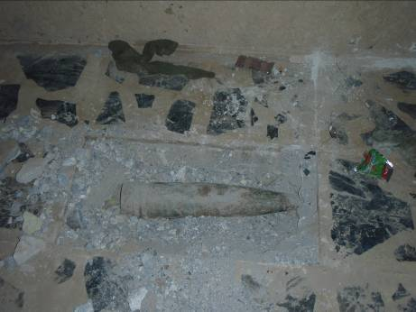
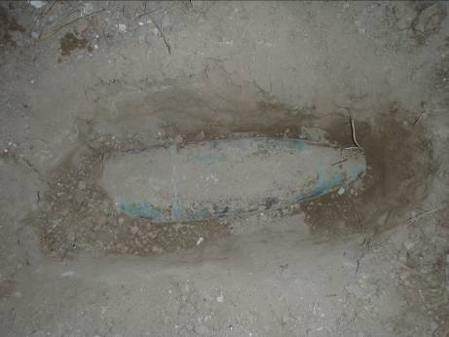
Common Threats ภัยคุกคามที่พบบ่อย
Emplaced IED / IED ซุกซ่อน
4th HME Container
125mm Russian HE Projectile outside combat aid station window
122mm Russian HE projectile In courtyard

Slide 9
Common Threats
Emplaced IED / IED ซุกซ่อน
เหนือ
ตก
ใต้
ออก
Notes:
Five prior similar incidents had obvious precursors; bricked up widows and partially obstructed entries that hindered the use of robotics.
• This structure had glass windows, tended garden, and appeared to have been recently occupied (Possible that AQI has been observing CF/ISF TTPs IRT detecting BBIED’s)
IA swept the house and called it clear, EOD element (w/ CF dog handler) commenced their outside sweep around the backside of the residence when IA forces reentered the front door.
Shortly after a detonation occurred inside the house, killing 1x IA soldier and wounding 4 others inside. The explosion inside the housed caused the outer wall where EOD was searching to collapse, burying 2 EOD techs and the Dog Handler.

Slide 10
Common Threats
Emplaced IED / IED ซุกซ่อน
Notes:
This photo is associated with previous slide

Slide 11
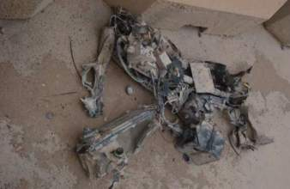
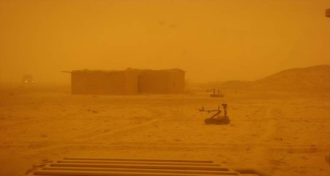
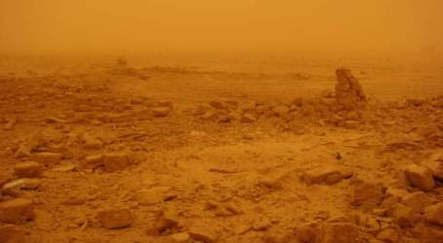
Common Threats
Emplaced IED
IED ซุกซ่อน
Robot After Detonation
Secondary Devices
After Detonation
Notes:
This first story board deals with an incident that happened in Iraq. This was a source driven incident and after establishing contact with an LN source at a check point near the home EOD were able to gather some information on the floor plans. Upon arriving on scene they deployed a robot and began a remote recon of the house and surrounding area prior to entering. The robot was maneuvered into the house and immediately identified 3-4 rooms. The robot entered the 1st room and identified two doors. EOD opted to search the room trough the right door. This room opened to a 2nd room which contained nothing but debris. The robot then proceeded to the 3rd room where it functioned a VO switch that initiated an IED. EOD conducted a secondary search outside of the house and found evidence a further three IEDs had detonated during the initial blast. During PBA, EOD identified two blast holes in rooms 1 and 3. The team determined the main charge of each detonation to be consistent with a 130 mm projectile or mortar, which was partially, confirmed when fragmentation from a 130mm mortar was located in one of the blast hole. No additional hazards were found.
EOD also believes that there was no viable reason to protect this house to the extent that it was, and it was the team leader’s assessment that this was a complex IED designed to attack first responders. The adversary intent was to draw the first responders toward the booby trapped building; when the dismounted patrol got approximately 2/3rds of the way into the house, the internal IEDs would detonate simultaneously with the IEDs outside. The external IEDs would detonate on any troops that were positioned against the outer walls of the house, while the primary entry team would be killed by the initial explosion inside the house.
Of additional note was that within the same week following the clearance of this house, a further three booby trapped houses were reported by the ISF within close proximity. While these were reported no story boards were provided.

Slide 12
Summary ทบทวน
Threat assessment
การประเมินภัยคุกคาม
Unoccupied building
อาคารร้าง
Common threats
ภัยคุกคามที่พบบ่อย

Slide 13
Unoccupied Building Search
Questions?

