Slide 1
EXPLOSIVES SAFETY
“STORAGE AREA SAFETY AND
DESIGN CONSIDERATIONS”
U.S. Marine Corps Forces, Pacific
Explosives Safety Officer
(ESO)
“Khun Mark” or “Khun Spencer”

Slide 2
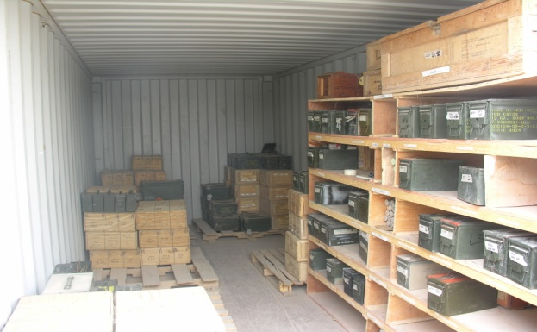
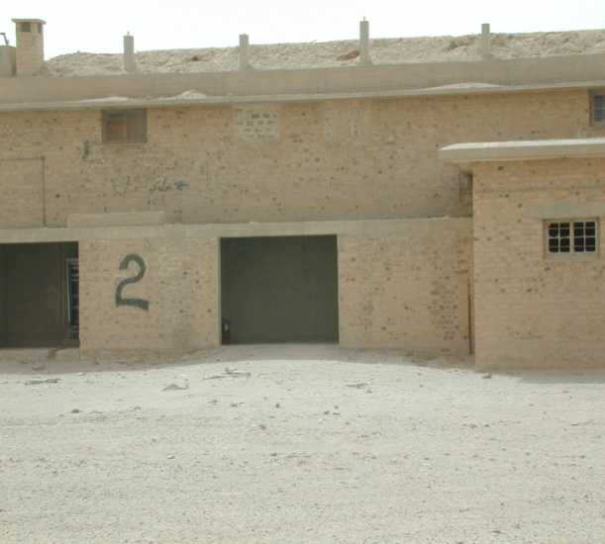
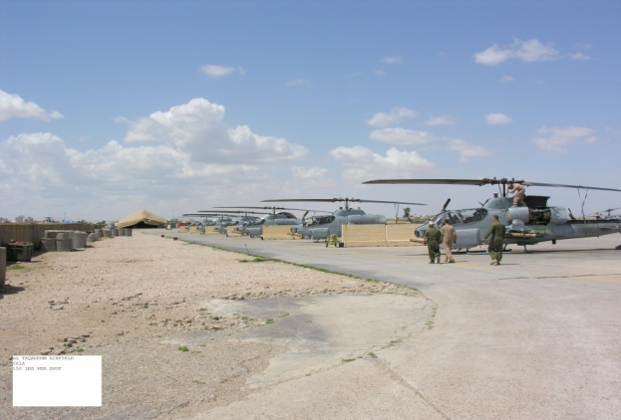
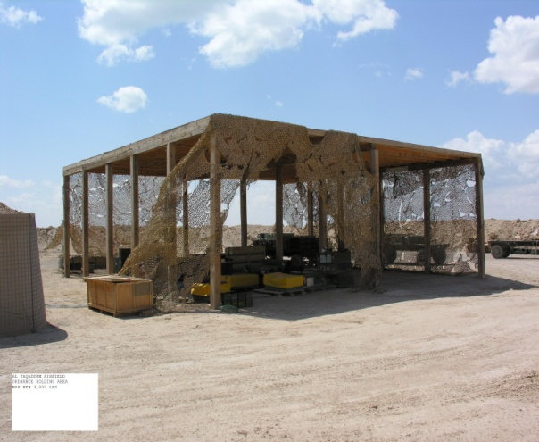
STORAGE CONSIDERATIONS
Common type of storage
Military-Owned Demountable Containers (MILVAN)/International Standards Organization (ISO) container
Open Storage Sites (Barricaded and Unbarricaded)
Vehicles
Local facilities
Common Barricades
Hercules Engineering
Solutions Consortium
(HESCO)
Jersey Walls
Steel Bin Barricades
Natural topography

Slide 3
STORAGE CONSIDERATIONS
Important Safety Considerations
At a minimum meet intermagazine distance (IMD) (K11)
Attempt to meet compatibility
Limit the amount of Hazard Class/ Division (HC/D) 1.1
Place less sensitive and unoccupied structures near storage areas
Keep a close watch on excess/unserviceable/foreign stocks
Use barricades
Ground containers

Slide 4
STORAGE CONSIDERATIONS
Common Storage Practices
Maintain an inspection aisle between rows
Stacks should not be higher than the barricade or crush the
lower pallets
Ensure there is enough spacing to allow the forklift to
maneuver
First in first out should be considered
Maintain original packaging
Excess dunnage not being accumulated
Keep stocks from sitting on the ground
Stocks in Military-Owned Demountable Containers (MILVANS) should be aired out in hot environments
Keep stocks dry. Tarps can be used but must be supported
above the ammunition (12 inches/30.48centimeters) and open on the sides
Housekeeping

Slide 5
AMMO STORAGE AREA COMPONENTS
Typical Components of an Ammunition Storage/Operating Area
Ammo Storage Area Components
Ammunition Storage Area
Field Office
Storage cells
Segregation Area
Truck Holding Area
Captured Enemy Ammunition Storage Area
Ammunition Staging Area
Sling Out Area
Aviation Ordnance Storage Area
Field Office
Storage cells
Segregation Area
Truck Holding Area
Captured Enemy Ammunition Storage Area
Ordnance Staging Area
Ordnance Build Up Area

Slide 6
STORAGE AREA
When selecting a site consider the following:
Site selected should have good all-weather characteristics
Storage areas must be adequately drained. Ammunition and explosives should not be placed or stored in low areas
Sufficiently level to facilitate operations
Take advantage of natural cover or protection
Discretion should be used, however, in selecting natural cover; for example, heavy woods provide good cover but they are damp in the winter and fire hazards in the fall and summer
Large enough to fulfill the immediate space requirements and provide for possible expansion
Located far enough away from inhabited buildings, airfields, petroleum product, petroleum oil lubricates (POL) storage and other similar locations to minimize risk
Provided with access roads and internal road networks to permit vehicles accessibility to any one section

Slide 7
TYPICAL STORAGE AREA
In a tactical environment storage selection is key
Types available
Field Storage Units (FSUs)
Basic Load Ammunition Holding Areas
Modular Storage Sites
Open Storage Sites
Type of storage selected is dependent upon
Total net explosives weight (NEW)
Available land
Construction Equipment Available
Length of time storage is required
Security considerations
Note: FSUs and modular storage are limited to sites outside the US unless approved by the Service Safety Center and the Depart of Defense Explosive Safety Board (DDESB)

Slide 8
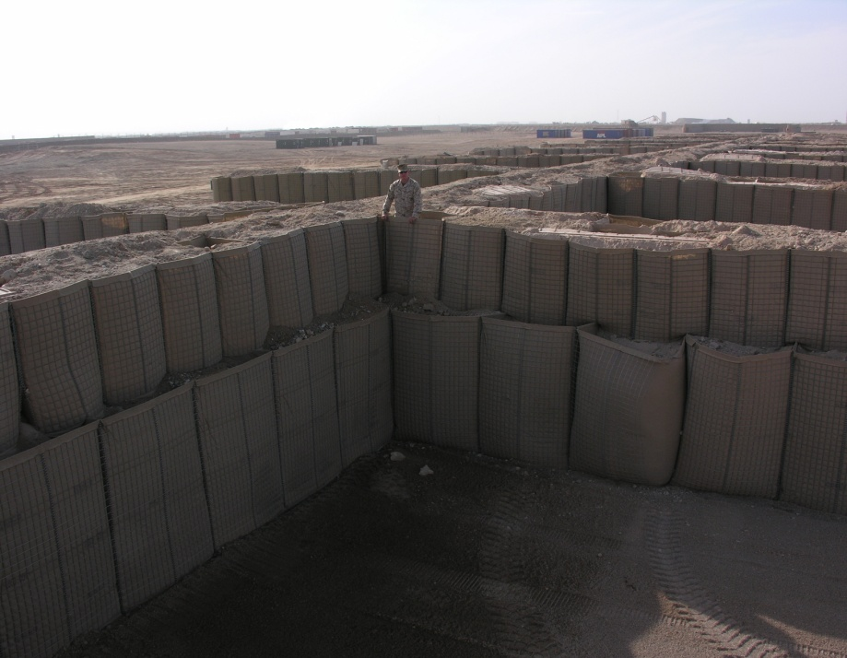
BASIC LOAD AMMO HOLDING AREA
Basic Load Ammunition Holding Area (BLAHA)
One of the most common types of storage areas constructed
BLAHA are used for individual small units, normally use International Standards Organization
(ISO) containers, mainly seen on Combat
Operating Base (COBs)
The advantages of a BLAHA are:
Ammunition is in close proximity
to using units
Able to store mixed compatibilities
Easy to establish
The disadvantages of a BLAHA are:
High risk to personnel, equipment
and facilities
Limited Net Explosives Weight
(NEW) storage (8820 lbs/4000 KG NEW per cell)

Slide 9
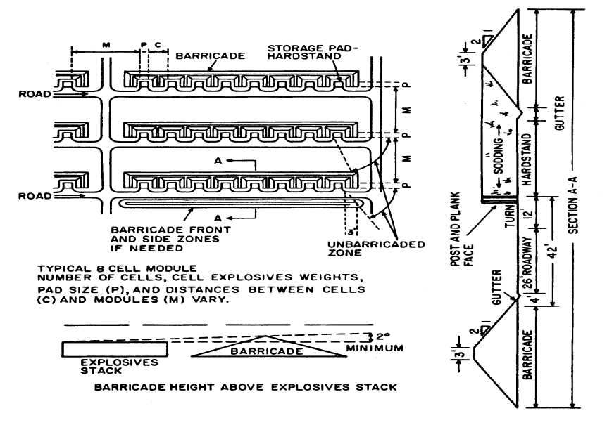
MODULAR STORAGE
Normally used for ammunition items with large net explosive weight NEW (Bombs)
Mostly seen in Aviation ordnance storage areas
The advantages of a modular storage system include:
Greatly reduced real estate requirements
Greatly improved security with comparable forces
Reduced transportation requirements within the
ammunition area
Reduced vulnerability to direct fire because of the
smaller area and barricades
The disadvantages include:
The possibility of explosion or fire in one cell starting fire
in other cells because of heat generation or indirect
fragment dispersion
Increased vulnerability to enemy indirect fire and air-
dropped bombs because of concentration of stocks
Additional engineer support required for initial
construction of modules as opposed to that required for
unbarricaded open storage
Limited types of ammunition allowed for storage
Notes:
9

Slide 10
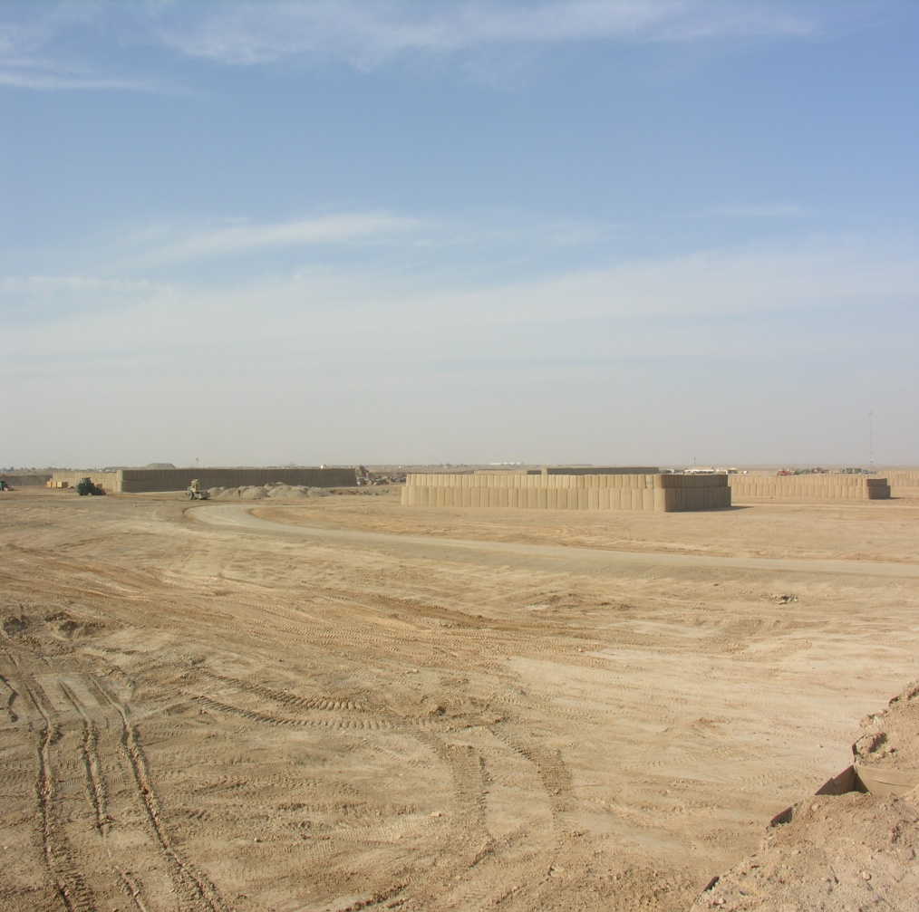
OPEN STORAGE CELLS
Normally used on Main Operating Bases (MOB)
Preferred method of storage
Advantages of Open Storage are:
Provide greatest amount of safety from an accidental explosion to non-essential personnel
Provide asset preservation
Easily site approved
No limitations on types of ammunition stored
The disadvantages of Open Storage are:
They require a large footprint
Require large amount of support
material to build.
Costly
Notes:
10

Slide 11
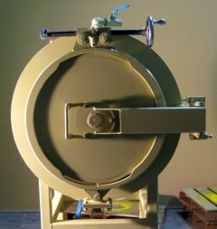
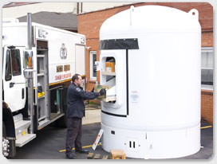
REDUCE MCE STORAGE
Specialized storage available to reduce distances
These types of storage have normally have strict limitations
Limited to specific types of ammunition
Have special storage instructions
Specific NEW limits
Costly
List of reduced storage options can be found in Department of Defense Explosive Safety Board (DDESB)
Technical Paper 15 (http://www.ddesb.pentagon.mil/index.asp)
Approved types include
NABCO (Zero-Arc Magazines)
GOLAN (Magazines)
CETASM (Canine Explosive Training Aid Storage Magazines)
Explosive Ordnance Disposal (EOD)
Notes:
11

Slide 12
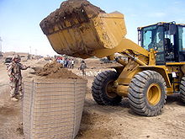
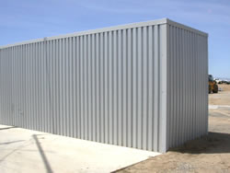
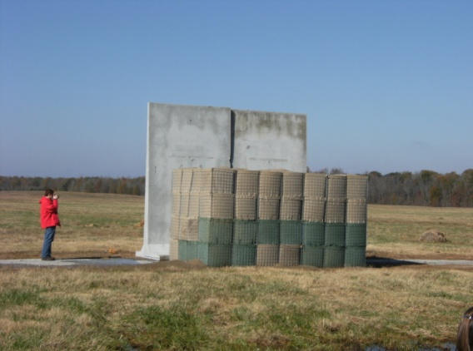
FIELD EXPEDIENT METHODS – REDUCING QUANTITY DISTANCE (QD)
Barricades are great for reducing maximum credible event (MCE) between stacks
Material used in construction of barricades ranges from Dirt/sand/water, free of hazardous materials, no items larger than 20mm in diameter or about ¾ inch
Containers include Steel bin/wire basket/cloth/synthetic
Most common types include
ARMCO Revetments (Steel Bin Barricades two types)
Hercules Engineering Solutions Consortium (HESCO) barricades
Limitation exist for each
Must be stacked correctly
Must meet width and height requirements
NEW limits
Specific locations
Fill material must meet certain conditions
No bigger than 20mm in diameter or about ¾ inch
Notes:
12

Slide 13
FIELD EXPEDIENT METHODS – REDUCING QUANTITY DISTANCE (QD)
Construction and location of earth filled barricades are important
Container configurations of 1, 2+1, 2+2 or 2+2+1 between adjacent storage containers should be used as the standard for ammunition areas in theatres of operations
Container configurations of 3+2 or 3+2+1 do not provide more protection but can produce more mass movement onto the adjacent storage container. Larger barricades are not recommended between potential explosion sites (PES) located but are more suitable in front of the container opening.
up to
(4000 kg) Net Explosive Quantity (NEQ) (8800lbs)
up to 1000 kg (2200lbs)
Between Cells
Open End

Slide 14
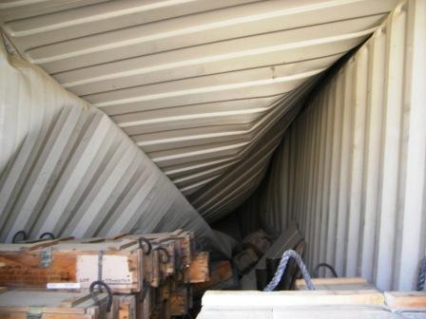
OPERATIONAL FIELD STORAGE METHODS
Storage methods to reduce maximum credible event (MCE)
These methods do not reduce quantity distance (QD) just lessen the effect
Buffered storage
Placing Hazard Class/Division (HC/D) 1.4 stacks between stacks of HC/D 1.1 and 1.2
Acts as a barricade to prevent propagation
Risk mitigating effort
International Standards Organization (ISO) container conversion
Allows the use of earth covered magazine
Better protection of ammunition
Requires strict construction compliance

Slide 15
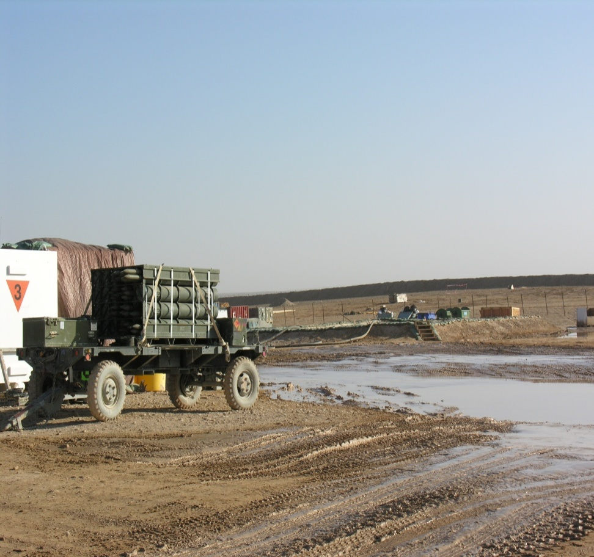
FUEL STORAGE
The amount of fuel determines the required separation distance
Ensure fuel storage sites meet the following requirements:
Fuel bladders for quantities up to 500 gallons/1,892.7 liters require at least 50 feet/15.24 meters separation distance from explosives storage/operating areas
Fuel bladders for quantities between 500 gallons/1,892.7 liters to 5,000 gallons/18,927 liters require at least a 100 feet/30.48 meters separation distance from explosives storage and operating areas
Fuel bladders for quantities over 5,000 gallons require inhabited building Distance (IBD) for explosives storage and operating areas
Notes:
15

Slide 16
STORAGE AREA SAFETY AND DESIGN CONSIDERATIONS
QUESTIONS?

