Slide 1
EXPLOSIVES SAFETY
“GENERAL REQUIREMENTS”
U.S. Marine Corps Forces, Pacific
Explosives Safety Officer
(ESO)
Mr. Mark Spencer
“Khun Mark” or “Khun Spencer”

Slide 2
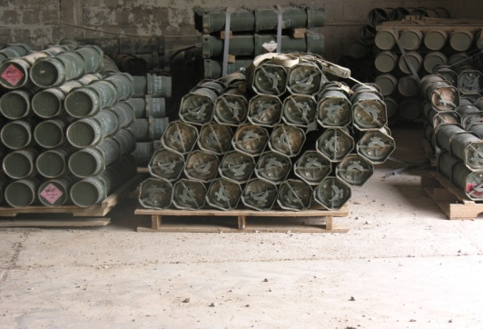
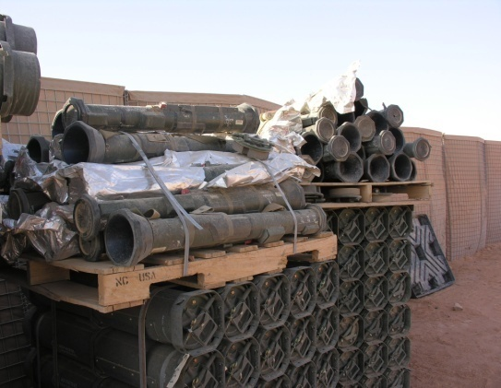
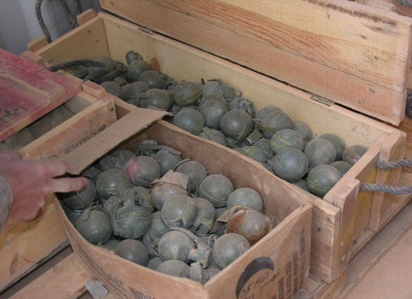
HANDLING
Proper handling of ammunition is critical
Ammunition in this environment is usually
Not properly packaged
Has been subjected to adverse environments (weather, transportation, use)
Careless handling of ammunition and explosives containers may dent cartridge cases, damage rotating bands of projectiles, break or damage containers, or obliterate identification markings
Actions may cause malfunctions
Cause the ammunition to become unserviceable
The following regulations shall be observed during ammunition and explosives handling operations:
Protect from mud, sand, dirt, and water
Separate Unserviceable from serviceable ammunition and explosives
Captured enemy ammunition and Coalition ammunition should be separated from U. S. or allied ammunition
Hazards of Electromagnetic Radiation to Ordnance (HERO) shall be taken into consideration

Slide 3
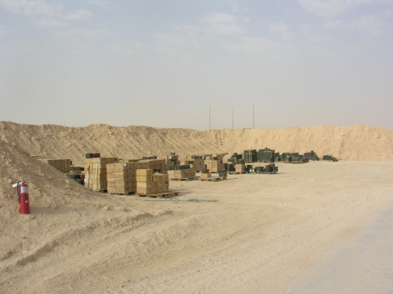
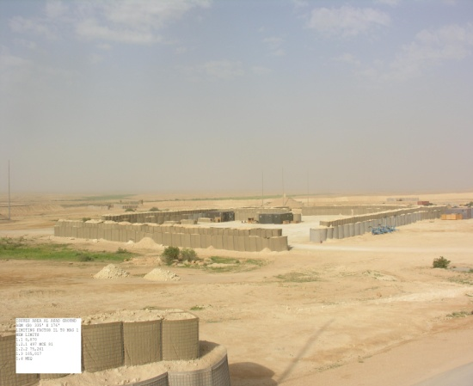
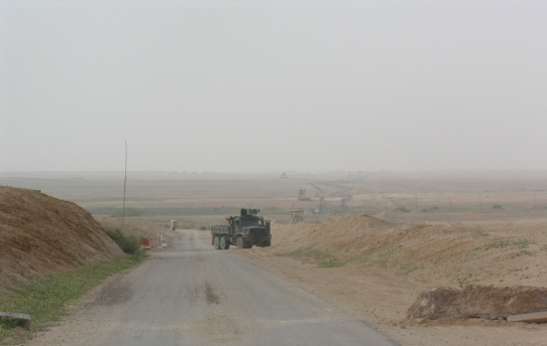
PHYSICAL SECURITY
Physical Security requirements contained in Marine Corps Order 5530.14A and Department of Defense Directive 5100.76
Unless storing in a Magazines or Military-Owned Demountable Container (MILVAN)/International Standards Organization
(ISO) containers ammunition will be stored in the open
Sites should be protected by berms so the area is not visible
If using electronic surveillance ensure electrically sensitive ordnance is safeguarded against transmissions
Access to ammunition. An access roster should be maintained
whether the ammunition is stored in an Ammunition Supply Point (ASP) or in a unit area
Local nationals and Coalition partners need to be considered.
limit the number of personnel in an ASP
Limit the number of areas where ammunition is stored

Slide 4
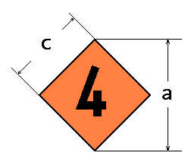
FIRE SAFETY
Fire is one of the greatest threats to ammunition and explosives. Fire fighting is dependent upon the contents and magazine type. Personnel safety and lifesaving must be taken into consideration prior to making the decision to fight a fire.
Fire Division 1
Fully developed fire must not be fought.
Fire Division 2
External ammunition fires can be fought in close proximity of the magazines except in the direction of the head-wall or doors.
No firefighting at all in case of light structure magazines
Fire Division 3
Fully developed fire must not be fought.
Fire Division 4
Fires involving items of Fire Division 4 may be fought as dictated by the situation.

Slide 5
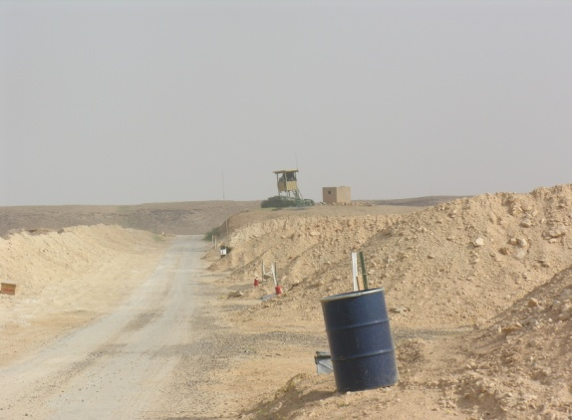
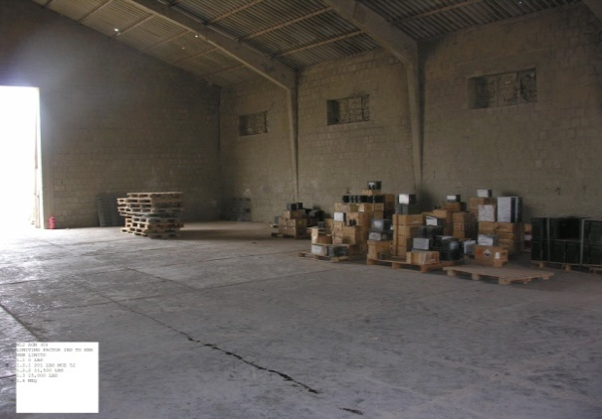
FIRE SAFETY
Fire is one of the greatest threats to ammunition and explosives
Fire can originate from natural causes (lightning), carelessness
enemy action (indirect fire), or from degrading ammunition
Vegetation should be cleared to 50 feet from the storage area, vegetation should be cut to a height no higher than 18 inches/0457 meters
Water barrels should be placed at locations where White
Phosphorus is stored
Fire boxes should be constructed and placed within the ASP and
Contain dry sand, water barrels and buckets, brushfire beaters, brooms and shovels. Burlap sacks, drums of water
Fire/Chemical symbols posted if they do not compromise
security
If applicable base/camp fire department is provided with
information on the ASP
Dunnage should be kept to a minimum

Slide 6
COMMUNICATION
Communication is both verbal and visual. Examples of communication include
Electronic communication should be furnished to explosives storage and operating areas to provide quality of life support in the event of accidents, incidents
The ASP should have a way to communicate with the fire department and security
Personnel should be provided with communication equipment when working in the ASP
Fire map should be developed and submitted to the base/camp fire department
Physical security should know the location of ammunition and storage areas
Communication plans and procedures should be developed to support operations both internal and external to ammunition and explosives area operations

Slide 7
PERSONNEL REGULATIONS
Ammunition handlers should be medically fit and possess proper license Material Handing Equipment (MHE) and Explosive Drivers
Ammunition handlers should be in a qualification/certification program
eQual/Advance Skill Management (ASM) Training Database
Articles of adornment should be kept to a minimum
Working parties if used must be supervised by a qualified/certified individual
Team Leader or above
Safety Briefings must be provided by use of Standard Operating Procedures (SOP)
Eating should not be conducted in the ASP, contamination from the explosives
Spark producing items should not be carried by personnel working around ammunition and explosives
Proper Personnel Protective Equipment (PPE) is required to be worn when
conducting Receipt , Storage, Segregation and Issue (RSS&I) Operations
Clothing that causes static electricity should not be worn when conducting operations with electrically sensitive ordnance
Notes:
7

Slide 8
EXPLOSIVES SAFETY
QUESTIONS?
Notes:
8

